Slide 1

WanderAlert
Meera Ameera

Slide 2
Project Objectives
1. Enhance Safety for Individuals with Dementia
Prevent wandering incidents by monitoring door activity and verifying the individual through facial recognition.
2. Alleviate Caregiver Burdens
Reduce the stress of constant supervision by providing real-time alerts for potential wandering events.
3. Provide Timely Alerts for Caregivers
Utilize AWS Simple Notification Service (SNS) to notify caregivers immediately when wandering is detected.

Slide 3
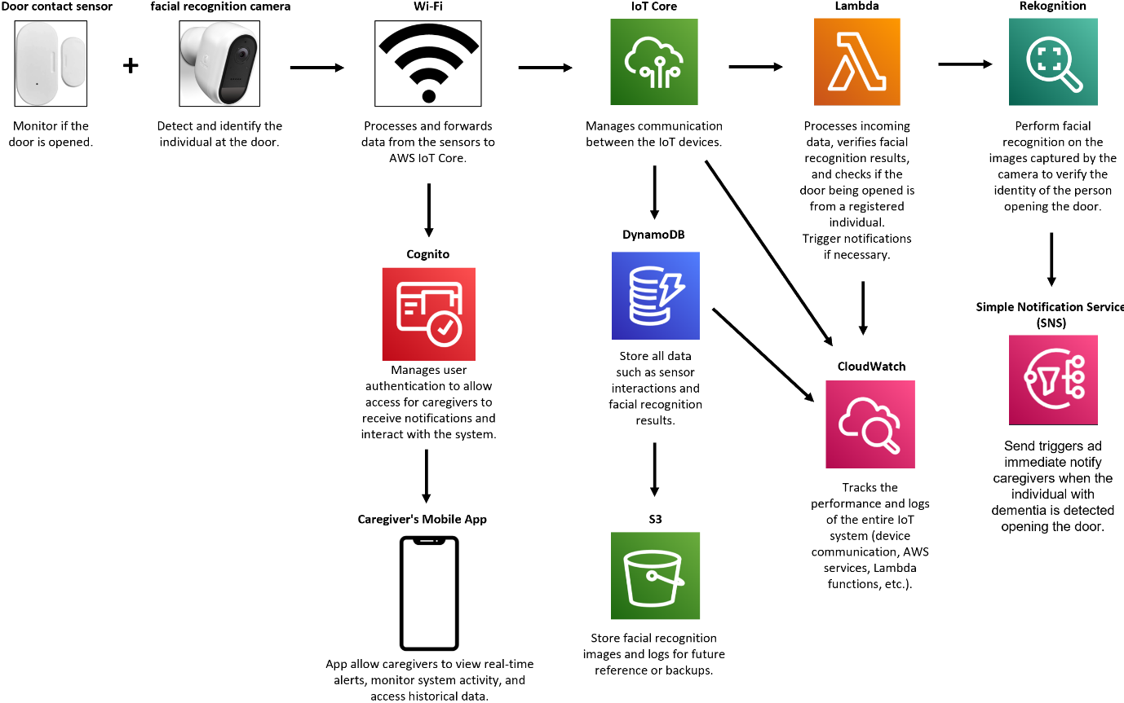
AWS Architecture Diagram

Slide 4
Services Used
1. IoT Core
Used to publish sensor data (door status and timestamp)
2. SNS
Send alerts to caregivers if an event is triggered, such as when the door is open and a recognized face was detected
3. Lambda
Processes login requests, do the facial recognition and fetching logs from DynamoDB.
4. API Gateway
Handles user authentication (login) requests by receiving email and password from the client
Triggers a Lambda function to validate the credentials by checking DynamoDB
Handles requests to fetch event logs

Slide 5
Services Used
5. DynamoDB
Stores logs and event data (like door events and timestamps)
6. S3
Stores images of events triggered by door sensors
The image files are linked to logs that are retrieved when displaying logs in the app.
7. Rekognition
Used for facial recognition to detect and identify individuals near the door.
8. Amplify
Host the website.

Slide 6
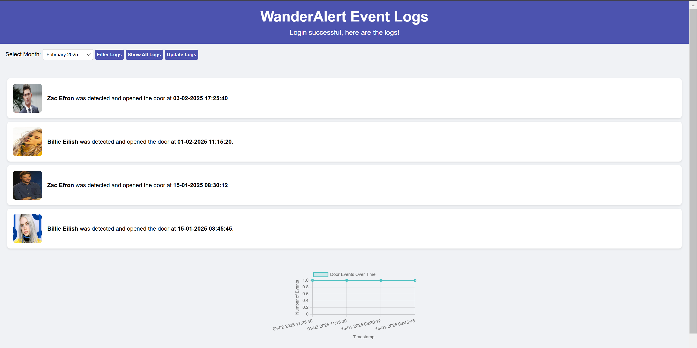
Website

